Slide 1
专题八 主从复合句
高考英语
北京市专用

Slide 2

目 录
定语从句
体系透视
重难透析
1.限制性定语从句 VS 非限制性定语从句 2.常用that不用which的情况
3.as的用法 4.“介词+关系代词”结构
5.“介词+关系代词”结构中介词的选用 6.where的用法
7.介词+关系副词 8.定语从句与并列句的区分
9.定语从句与强调句的区分 10.定语从句与状语从句的区分

Slide 3
目 录
名词性从句
体系透视
重难透析
1.that的用法
2.whether与if的区别
3.because的用法
4.as if/though的用法
5.连接代词的用法

Slide 4
目 录
状语从句
体系透视
重难透析
时间状语从句
1.when和while
2.as引导时间状语从句的用法
3.since引导时间状语从句的用法
4.till与（not...）until
5.“一……就”
6.before的用法

Slide 5
目 录
原因状语从句
条件状语从句
让步状语从句
1.although与though
2.as引导让步状语从句的用法
3.while引导让步状语从句的用法
4.“疑问词+ever”VS“no matter+疑问词”
5.whether...or的用法

Slide 6
目 录
目的状语从句
结果状语从句
so...that与such...that的区别
比较状语从句
综合考点
1.状语从句的省略
2.定语从句、名词性从句和状语从句辨析

Slide 7
目 录
考点针对练
题组一 定语从句
题组二 名词性从句
题组三 状语从句

Slide 8
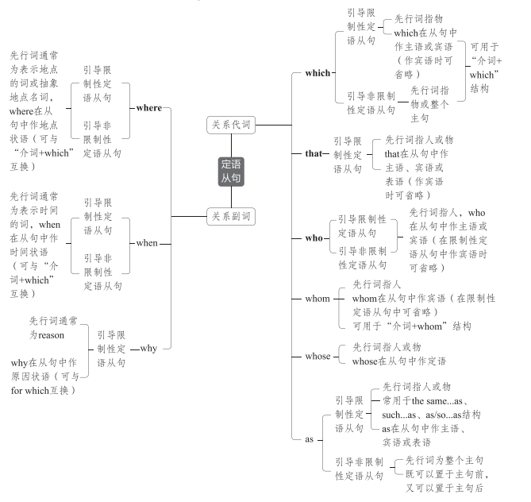
定语从句
定语从句在句子中起定语的作用,功能上相当于形容词,用于修饰名词或代词。定
语从句的难点在于如何准确判断应该使用关系代词还是关系副词。
体系透视

Slide 9
重点透析
1.限制性定语从句VS非限制性定语从句
限制性定语从句 | 对先行词起修饰、限制作用,是先行词不可缺少的定语,如果省略,所修饰的先行词往往不明确,因此前面不用逗号
非限制性定语从句 | 为先行词提供补充信息,起附加说明作用,即使去掉也不会影响先行词的明确性,常用逗号与主句隔开;除用于对具体事物补充信息外,还可以是针对整个主句内容的说明
We knew the scientist who had studied the problem. 我们知道那个研究过该问题的科学家。
(若把从句去掉,则不知道是哪位科学家)
We knew the scientist Hawkins, who had studied the problem. 我们知道科学家霍金斯,他
研究过该问题。(若把从句去掉,仍然知道是哪位科学家)
Laura couldn't come to our party, which was a pity. 劳拉不能来参加我们的聚会,这真遗憾。
(针对整个主句内容的说明)

Slide 10
2.常用that不用which的情况
(1)当先行词是all、little、much、few、everything、nothing、none等不定代词或被
all、little、much、few、every、no等修饰时
He did everything that he could to help us.
他竭尽全力帮助我们。
(2)先行词前有形容词最高级或序数词修饰时
This is the most interesting film that I've ever seen. 这是我看过的最有趣的电影。
(3)先行词前有the last、the only、the very、the right、the same等词修饰时
The only thing that we can do is to give you some practical advice. 我们唯一能做的事就
是给你一些实用的建议。

Slide 11
(4)当主句是what(about)引导的疑问句时
What about using the tools that don't need power supply?
用那些不需要电源的工具怎么样?
(5)当先行词既有人又有物时
Later they talked of things and persons that they remembered in the school. 后来,他们谈论
了他们记得的学校里的人和事。
(6)当关系代词在从句中作表语时(只限于限制性定语从句)
China is no longer the country that it used to be.中国不再是过去的那个国家了。
(7)为避免重复
The businessman built up a small factory, which produced things that were suitable for
children.这个商人建了一家小工厂,生产适合孩子们用的东西。

Slide 12
3.as的用法
(1)as的基本用法
①引导限制性定语从句时,常用于such...as、as/so...as、the same...as结构。先行词既可
以指人又可以指物。as在从句中可作主语、宾语、表语。
②引导非限制性定语从句时,先行词为整个主句,可表示与前面情况相同,常译为“正
如”。
As the Chinese philosopher Lao Zi wrote, “A journey of a thousand miles begins with a
single step.” 正如中国哲学家老子所写:“千里之行,始于足下。”

Slide 13
(2)as与which的区别(引导非限制性定语从句)
区别 | 例句
as引导的从句可置于句首、句中或句末,而which引导的从句只能置于先行词后 | As we all know, our country is developing at a high speed. 众所周知,我们的国家正在高速发展。 He is always being praised, which makes others unhappy. 他总是被赞扬,这使其他人不开心。
as引导非限制性定语从句时可以表达“正如”之意,而which无此意

Slide 14
易混易错 the same...as...与the same...that...
This is the same dictionary as I lost.(同类不同物)
这本词典和我丢的那本一样。
This is the same dictionary that I lost.(同类同物)
这是我丢的那本词典。
such...as...与such...that...的区别
The teacher asked such a difficult question as no one could answer.(as引导定语从句,指代
question,在从句中作answer的宾语)老师问了一个没有人能答出来的难题。
The teacher asked such a difficult question that no one could answer it.(such...that引导结果
状语从句)老师问了一个如此难的问题,以至于没有人能答出来。

Slide 15
4.“介词+关系代词”结构
(1)当介词放在关系代词前面时,关系代词常用which(指代物)或whom(指代人),并且不
能省略。
In the dark street, there wasn't a single person, to whom she could turn for help.
在黑暗的街道上,没有一个她可以求助的人。
(2)“介词+关系代词”引导定语从句时,可用与之意义对应的关系副词when、where、
why替换;“名词+of which”引导定语从句时,可用“whose+名词”替换。
It dates back several thousand years to the use of longgu—animal bones and shells on
which (=where) symbols were carved by ancient Chinese people.它可以追溯到数千年前使用龙骨——动物骨头和贝壳的时期,中国古人在其上雕刻符号。
The house the window of which(=whose window) faces south is mine.
窗户朝南的那所房子是我的。

Slide 16
5.“介词+关系代词”结构中介词的选用
“介词+关系代词”结构中介词的选用,应根据定语从句中动词与先行词的搭配以
及具体意义来确定。
I'll never forget the time during which I spent my childhood in the country.(during the time)
我永远不会忘记我在乡下度过童年的那段时光。
We should consult Mr. White, without whom we can't solve the problem. 我们应该向怀特
先生请教,没有他我们解决不了这个问题。

Slide 17
6.where的用法
关系副词where的先行词除了可以是表示具体地点的词外,还可以是case、condi-
tion、part、point、situation、stage等表示抽象地点的词。
It's helpful to put children in a situation where they can see themselves differently.
让孩子们处在他们能以不同的方式看待自己的状况中是有帮助的。
注意 occasion作先行词时,若指“时候;时刻;时机”,要用关系副词when;若指“仪式;
庆典;场合”,则要用关系副词where。
I can remember very few occasions when he had to cancel the meeting because of ill health.
我记得他因健康状况不佳而被迫取消会议的情况绝无仅有。

Slide 18
7.介词+关系副词
有时为了表达清晰,可以在关系副词where或when前加介词。
The wretched man stood at the top of the hill, from where he caught sight of the whole city
in fire. 这个可怜的人站在山顶上,从那里他看到了整个城市在大火中。
The book was written in 1946, since when the education system has witnessed great
changes.这本书写于1946年,自那时起,教育体系发生了巨大变化。
Our English teacher is always occupied in correcting homework and preparing lessons until
11 p.m., by when we have got to sleep.
我们的英语老师总是忙于批改作业和备课直到晚上11点,到那时我们都睡着了。

Slide 19
8.定语从句与并列句的区分
并列句中的几个分句通常由and、but、so等并列连词或分号连接。而定语从句中
的主句和从句通常由关系词连接。
Mr. Green has three daughters, but none of them is an engineer.(并列句)
格林先生有三个女儿,但她们都不是工程师。
Mr. Green has three daughters, none of whom is an engineer.(定语从句)
格林先生有三个女儿,她们中没有一个是工程师。

Slide 20
9.定语从句与强调句的区分
强调句的常见结构是“It is/was+被强调部分+that/who+从句”,被强调部分可以是
除了谓语动词之外的大部分成分。在这一句型中,强调句只起强调作用,不起修饰限定
作用。
It was on the morning of May 1st that I met Liang Wei at the airport.(强调句)
我是在5月1日的早晨在机场遇到梁伟的。
It is the factory that/which Mr. Wang works in.(定语从句)
这是王先生工作的工厂。

Slide 21
10.定语从句与状语从句的区分
①定语从句有先行词,而状语从句没有先行词;
②定语从句常在先行词之后,用来限制、描绘或说明先行词;状语从句常用来说明主句
的动作发生的情况,可以放在主句的前面。
I still remember the day when my friend could walk again.(定语从句)
我仍记得我的朋友能再次走路那天。
I was close to tears when my friend gradually stood up and made her first step after the car
accident.(时间状语从句)
当我的朋友在车祸后渐渐站起来迈出她的第一步时,我几乎要哭了。

Slide 22
Approximately 40 percent of the world's population live where mosquitoes transmit malaria.
(地点状语从句)世界上约有40%的人口生活在蚊子传播疟疾的地方。
Approximately 40 percent of the world's population live in the climate zone where
mosquitoes transmit malaria.(定语从句)
世界上约有40%的人口生活在蚊子传播疟疾的气候带。

Slide 23
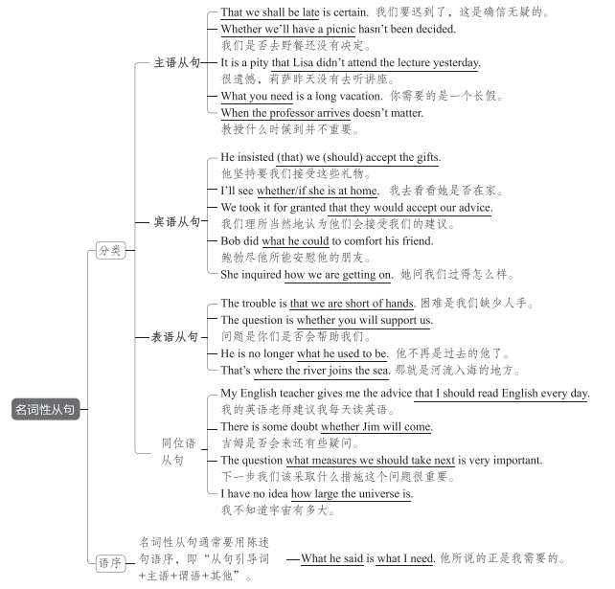
名词性从句
名词性从句在句子中起名词的作用,功能上相当于名词(短语),可在主从复合句中
充当主语、宾语、表语、同位语。因此,名词性从句可分为主语从句、宾语从句、表
语从句、同位语从句。
体系透视

Slide 24
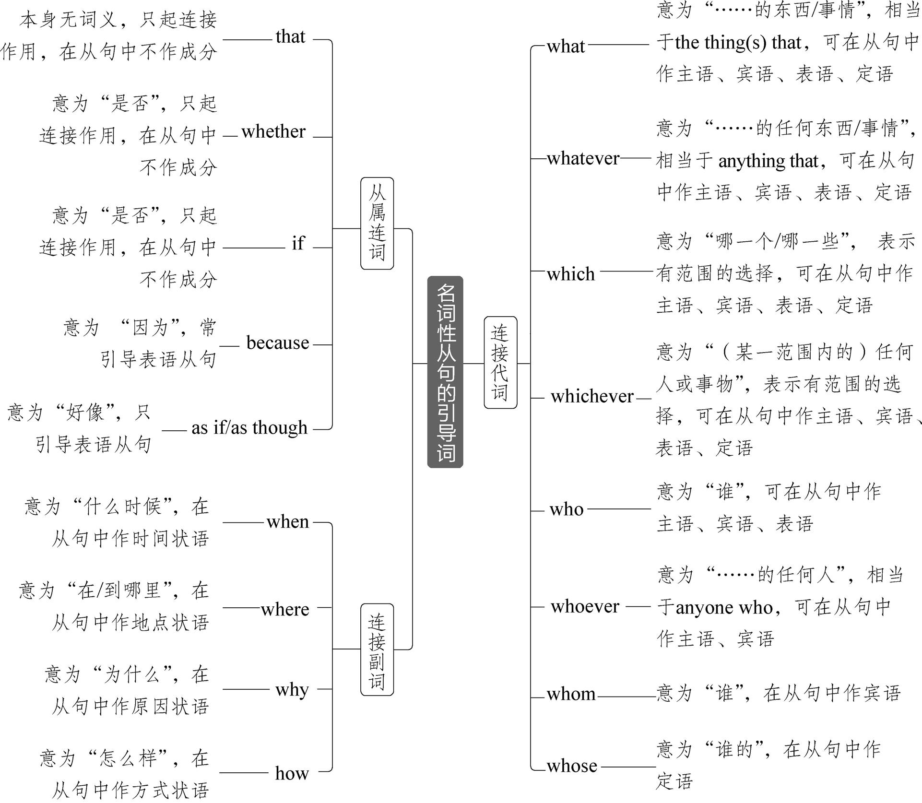
名词性从句常用的引导词有以下三类:

Slide 25
重难透析
1.that的用法
(1)that引导主语从句
that引导主语从句时,如果从句过长,为避免句子头重脚轻,我们常用it作形式主语,
而把主语从句放在句尾。常见的句型有:
句型 | 常用词语 | 例句
It+be+形容词+that 从句 | obvious、true、natural、surprising、good、wonderful、funny、possible、likely、certain、probable等 | It is certain that she will do well in her exam.她肯定会考得很好。

Slide 26
句型 | 常用词语 | 例句
It+be+名词(短语)+that 从句 | no wonder、an honor、a good thing、 a pity、no surprise等 | It's no surprise that our team has won the game.我们队赢了那场比赛并不令人惊奇。
It+be+过去分词+that从句 | said、reported、thought、expected、 decided、announced、arranged等 | It is said that Mr. Green has arrived in Beijing.据说,格林先生已经到北京了。
It+动词(短语)+that从句 | seem、appear、happen、occur、turn out、make no difference等 | It happened that he was out. 他碰巧出去了。 It turns out that he is silly. 事实证明他很愚蠢。

Slide 27
(2)that引导宾语从句
that可引导宾语从句,作及物动词或介词的宾语。
Do you know (that) he has joined the army?
你知道他参军了吗?
注意 以下两种情况,常用it作形式宾语:
①find、feel、think、consider、make、believe等后有宾语补足语时,需用it作形式宾语,
而将that引导的宾语从句后置。
He has made it clear that the meeting will not be postponed.
他清楚地表明会议不会被推迟。
②一些动词短语,如see to、depend on、rely on 等常用it作形式宾语,而将宾语从句后置。
I shall see to it that he is taken good care of when you are absent.
你不在的时候,我保证会照顾好他。

Slide 28
(3)that的省略
that引导主语从句、表语从句、同位语从句时一般不省略,但在口语中或用于引导及物
动词后的宾语从句时,that可以省略。
注意 以下两种情况,that一定不省略:
①that引导的从句位于句首时。
That different countries have different cultures is natural.
不同的国家有不同的文化是很自然的。
②动词后有多个that引导的宾语从句时,只有第一个that可以省略,从第二个从句开始,
that不可省略。
He said (that) he would attend the party and that he would announce a piece of inspiring
news.他说他将参加这个聚会,并将宣布一个鼓舞人心的消息。

Slide 29
2.whether与if的区别
whether可用于引导主语从句、宾语从句、表语从句和同位语从句。
if主要用于引导及物动词后的宾语从句,有时可用于引导主语从句(只能置于句末)。
注意 常用whether不用if的情况
①引导介词后的宾语从句、表语从句、同位语从句时。
It all depends on whether the sky will clear up. (介词后的宾语从句)
这完全取决于天是否会放晴。
The question is whether the film is well worth seeing.(表语从句)
问题是这部电影是否很值得看。
They raised the question whether we ought to call in a specialist. (同位语从句)
他们提出了我们是否应请专家来的问题。

Slide 30
②引导主语从句,且从句置于句首时。
Whether it is true remains a problem. 这是否属实仍然是个问题。
③后紧跟or not时。
Can you tell me whether or not the train has left?
你能告诉我火车是否已经开了吗?
注意:当or not不紧跟在后面时,whether与if可以互换。
Please tell me if/whether you will go to the lecture tomorrow or not.
请告诉我你明天是否去听讲座。
④与动词不定式连用时。
I don't know whether to refuse or accept. 我不知道是拒绝还是接受。

Slide 31
3.because的用法
because常用于引导表语从句,且常用于“It/This/That is because...”结构。
This is because people believe in the importance of carrying on space exploration despite
the huge risks. 这是因为尽管有巨大的风险,人们还是相信进行太空探索的重要性。
4.as if/though的用法
as if/though引导名词性从句时,只引导表语从句,意为“好像”。
She looked as if she had had some bad news.
她看上去好像听到了什么坏消息似的。
It sounds as though he's been really ill.
听起来他好像真的病了。

Slide 32
5.连接代词的用法
(1)what与who
what一般指事物,而who一般指人物的身份或特征。
He told us what had happened.(事情) 他告诉我们发生了什么事。
I firmly believe that what he said at the meeting is right.(他所说的话的内容)
我坚信他在会上说的是对的。
After what seemed a long time, the beggar left without a word.(时间)
似乎过了很长时间,乞丐一言不发地走了。
Nelson Mandela not only made South Africans feel good about being who they are, but he
was also an amazing gift to humankind.(身份)纳尔逊·曼德拉不仅让南非人对自己的身份感到满意,他还是给人类的一件令人惊叹的礼物。
Who is brave enough to face the challenge will be rewarded.(特征)敢于面对挑战的人将会得到奖励。

Slide 33
(2)what与which
what一般没有具体的范围,而which一般指在具体范围内进行选择。
Can you tell me what coffee you would like to have?(没有给出选择范围)
你能告诉我你想喝什么咖啡吗?
Can you tell me which coffee you would like to have, black or white?
(在黑咖啡和加奶咖啡中选择)
你能告诉我你想喝哪种咖啡吗,黑咖啡还是加奶咖啡?

Slide 34
知识链接 定语从句与名词性从句
①众所周知,地球绕着太阳转。
As is universally acknowledged, the earth runs around the sun.(As引导定语从句)
The earth runs around the sun, which is universally acknowledged.(which引导非限制性定语从句)
That the earth runs around the sun is universally acknowledged.(That引导主语从句)
=It is universally acknowledged that the earth runs around the sun.(that引导主语从句)
What is universally acknowledged is that the earth runs around the sun.(What引导主语从句,that引导表语从句)
②that引导的同位语从句和定语从句的区别
The news that our football team won the game was encouraging.
(that引导同位语从句,起连接作用,不充当句子成分)
The news (that) we heard on the radio was not true.(that引导定语从句,在从句中作宾语,可省略)

Slide 35
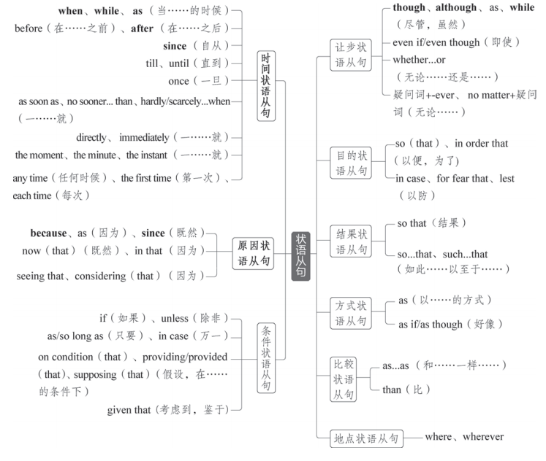
状语从句
状语从句在句子中起状语的作用,可用来修饰主句或主句中的动词、形容词或副词。与定语从句和名词性从句一样,状语从句通常有引导词。根据其意义和在句中作用的不同,状语从句可分为以下9种:
体系透视

Slide 36
重难透析
时间状语从句
1.when和while
when和while都可以用于引导时间状语从句,两者用法有很多共同之处,但也有区别:
(1)when引导时间状语从句可表示主句动作与从句动作同时发生,也可以表示从句动作
与主句动作先后发生。
It was snowing when we arrived. 我们到达时,天正下着雪。
I'll let you know when it is arranged. 此事安排好后,我会告诉你。

Slide 37
(2)while引导时间状语从句可表示主句动作与从句动作同时发生,意为“一边……一边
……”。
While she sang, she danced. 她边唱边跳。
注意
①while可置于句首,引导让步状语从句,意为“虽然,尽管”。(详见本专题“让
步状语从句”部分)
②while可用作并列连词,表示前后对比,意为“而”。(详见专题七“并列连词与并列
复合句”)

Slide 38
2.as引导时间状语从句的用法
as可用于引导时间状语从句,常译为“当……时”,可与when或while互换,也可以
转化为with的复合结构。此外,as也有“随着”的意思。
When/While/As the earth travels round the sun, it turns around on its own.
地球绕太阳转的同时还自转。
As time goes by, private cars are more and more popular.
=With time going by, private cars are more and more popular.
随着时间的推移,私家车越来越受欢迎。
注意 as还可以引导原因状语从句(详见本专题“原因状语从句”部分)、让步状语从
句(详见本专题“让步状语从句”部分)、比较状语从句和方式状语从句。

Slide 39
3.since引导时间状语从句的用法
(1)since的基本用法
since意为“自从……以来/之后”,引导的时间状语从句的谓语动词一般是非延续性动
词,用一般过去时;主句的谓语动词是延续性的或者是反复发生过的动作,其时态常用现
在完成时或现在完成进行时。
I have written home four times since I came here.
自从来到这儿,我已经给家里写过四次信了。
She has been working in this factory since she left school.
她离开学校以后就一直在这个工厂工作。

Slide 40
(2)It+be+一段时间+since从句
在这个句型中,since引导的从句的谓语动词若是延续性动词,则时间从since从句的动作
或状态结束时算起;若since引导的从句的谓语动词是非延续性动词,则时间从动作开始
时算起。
It is three years since the young man joined the army. 那个年轻人已经参军三年了。
(join为非延续性动词,时间从动作开始时算起,即自“他参军”那一刻起已经有三年了)
It is three years since the young man was in the army. 那个年轻人已经退伍三年了。
(be为延续性动词,时间从动作结束时算起,即自“他在军队”这件事结束已经有三年了)
注意 since还可以引导原因状语从句(详见本专题“原因状语从句”部分)。

Slide 41
4.till与(not...)until
(1)till与until都意为“直到”,一般可互换,但置于句首时,一般不用till。
Cholera used to be one of the most feared diseases in the world, until/till a British doctor,
John Snow, showed how it could be overcome. 霍乱曾经是世界上最可怕的疾病之一,直
到一位英国医生约翰·斯诺证明了它可以如何被攻克。
Until you told me, I heard nothing of what had happened.
直到你告诉我为止,出了什么事我一点也不知道。
(2)not...until意为“直到……才”。
直到他回来,我才离开。
一般句式:I didn't leave until he came back.
倒装句式:Not until he came back did I leave.
强调句式:It was not until he came back that I left.

Slide 42
5.“一……就”
分类 | 引导词 | 例句
连词 | as soon as | Lang is only too aware that as soon as a team steps off the victory podium, they need to start from zero to prepare for new challenges ahead. 郎平非常清楚,一支球队一走下领奖台,就需要从零开始,为未来的新挑战做好准备。
名词短语 | the moment、the minute、the instant | Your lights will come on the instant you enter the door along with your favourite music or TV programme, and you will find your dinner already prepared for you. 你一进门,你的灯就会亮起来,同时你最喜欢的音乐或电视节目会被播放,并且你会发现你的晚餐已经为你准备好了。
可用作副词的连词 | directly、immediately | I came directly I got your message.我一收到你的消息就赶来了。
固定结构 | no sooner...than、 hardly/scarcely...when | No sooner had we got home than it began to rain. =We had hardly got home when it began to rain.我们刚到家就开始下雨了。

Slide 43
6.before的用法
(1)用在“It was/will be...before...”结构中,表示“要过……才……”
It will be another five days before we finish this task.
我们还需要五天才能完成这项任务。
(2)用在“It wasn't/won't be...before...”结构中,表示“没过……就……”
It was not long before I forgot it all. 没过多久我就把这一切都忘了。
(3)before有时可以翻译为“还没来得及……就”或“以免”
The roof fell before he had time to dash into the room to save his baby.
他还没来得及冲进房间救他的孩子,房顶就塌了。
I must write it down before I forget it. 我必须把它记下来,以免忘了。

Slide 44
原因状语从句
because引导的原因状语从句语气最强,回答由why提出的问题通常用because引导
的句子。as、since和now (that)引导的原因状语从句语气较弱,通常表示已知的事实,且
since一般置于句首。
The ground is wet because it rained last night.由于昨晚下雨,地面是湿的。
As/Since/Now (that) you are a student, I am strongly for the activity because it is very
meaningful and helpful.
由于你是一名学生,我非常支持这个活动,因为它很有意义,也很有帮助。
注意 for也可以表示“因为”,但它是并列连词,用于连接并列分句,而非引导原因状
语从句,且通常需要用逗号与前一分句隔开。
It must have rained last night, for the ground is wet.昨晚一定下雨了,因为地面是湿的。

Slide 45
条件状语从句
引导条件状语从句的词或词组有if(如果)、unless(除非)、as/so long as(只要)等。
He'll accept the job unless the salary is too low./He'll accept the job if the salary is not too
low. 除非工资太低,否则他会将受这份工作的。
/如果工资不是太低,他会接受这份工作的。
As/So long as we don't lose heart, we'll find a way to overcome the difficulty.
只要我们不灰心,我们将会找到克服困难的办法。

Slide 46
让步状语从句
1.although与though
共同点 | ①意思相同,都表示“虽然,尽管” ②都可以与yet、still、nevertheless连用,但不能与but连用 ③一般情况下可互换使用
不同点 | ①although一般置于句首,though可置于句首或句中 ②though引导的从句可以倒装,although引导的从句一定不倒装 ③与even连用时,只能用though
Even though Tu Youyou is not interested in fame, she has become a scientist whose work is internationally renowned.
虽然屠呦呦对名望不感兴趣,但她已经成为一名研究成果享誉国际的科学家。

Slide 47
2.as引导让步状语从句的用法
as引导的让步状语从句一定要倒装。
Simple as/though the picture is, the underlying meaning cannot be ignored.
尽管图片很简单,但其隐含的意义不容忽视。
3.while引导让步状语从句的用法
while引导让步状语从句时,一般置于句首,且不倒装。
While I admit that there are problems, I don't agree that they cannot be solved.
尽管我承认有问题,但我认为这些问题不是不能解决。

Slide 48
4.“疑问词+-ever”VS“no matter+疑问词”
“no matter+疑问词”只能用于引导让步状语从句(此时可与“疑问词+-ever”互
换,从句谓语动词一般与情态动词may/might连用以加强语气)。
“疑问词+-ever”除可以引导让步状语从句以外,还可以引导其他状语从句和名词性
从句。
If the baby is put into an unfamiliar playroom without its mother, the baby ignores the toys
no matter how interesting they might be.(引导让步状语从句) 如果这个婴儿被放在一个陌生的没有妈妈在的游戏室,那么无论玩具多有趣,这个婴儿都会忽略这些玩具。

Slide 49
Whichever and whatever you like, there is an incredible theme park that will appeal to you!
(引导让步状语从句)无论你喜欢哪一个或喜欢什么,都有一个非常棒的主题公园会吸
引你!
Studying hard isn't always fun, but I'll be well prepared for university or whatever else
comes in the future. (引导介词后的宾语从句)努力学习并不总是有趣的,但我会为大学
或未来发生的其他任何事情做好充分准备。
We can download software, documents, and images whenever we need them. (引导时间状
语从句)我们可以随时下载需要的软件、文档和图像。

Slide 50
5.whether...or的用法
whether...or意为“无论/不管/不论……还是”,其引导的让步状语从句有时可用虚
拟语气,动词用原形。
Whether we beat them or they beat us, the match will be enjoyable. 不管是我们打赢他们,
还是他们打赢我们,这场比赛都将是好看的。
注意 当whether...or引导的让步状语从句中谓语动词用虚拟语气,且动词为be时,可以
省略whether,将动词be移至句首,用动词命令式引导让步状语从句。
Whether the figures be accurate or not, they have to be rechecked.
=Be the figures accurate or not, they have to be rechecked. 不管这些数字准确与否, 都必须重新检查。

Slide 51
目的状语从句
so (that)、for fear that、in order that引导的目的状语从句常带有can、may、
could、might等情态动词。
I am always attentive in all classes and think actively,so that I can have more free time to
do other things that I'm interested in after school.
在所有课上,我总是专心听讲,并积极思考,以便放学后我能有更多的空闲时间去做其
他我感兴趣的事情。
The traveller set off early for fear that he might miss the early bus. 这位旅客很早就出发
了,生怕赶不上早班车。

Slide 52
结果状语从句
so...that与such...that的区别
so+ +that从句
such+ +that从句
Mr. Moore is such a learned and wise person that we can never admire him too much.
=Mr. Moore is so learned and wise a person that we can never admire him too much.
摩尔先生是一位如此博学且睿智的人,我们对他再怎么钦佩也不为过。

Slide 53
比较状语从句
比较状语从句用于把从句中叙述的事和主句中叙述的事进行比较。
He considered her opinion as valuable as any of ours.
他认为她的意见同我们的所有意见一样有价值。
I spent more than I intended to. 我花费的比我原先打算的要多。
The time available is less than we had hoped for. 可利用的时间比我们原先希望的少。

Slide 54
综合考点
1.状语从句的省略
如果条件、时间、地点、方式或让步等状语从句的谓语含有be动词,且从句主语
和主句主语一致,或者从句主语是it,常把从句的主语和be动词省略。
If (it is) possible, please contact me at your earliest convenience. 如果可能的话,请在您方
便的时候尽早与我联系。
However frequently (they are) performed, the works of Beethoven always attract large au-
diences. 无论演得多么频繁,贝多芬的作品总是吸引着大量观众。

Slide 55
2.定语从句、名词性从句和状语从句辨析
引导词 | 定语从句 | 名词性从句 | 状语从句
as | √ |  | √
that | √ | √
which | √ | √
when | √ | √ | √
where | √ | √ | √
what |  | √
how |  | √
why | √ | √
我去了他工作的地方。
I went to the place where he worked.(定语从句) I went to where he worked.(宾语从句)
I went where he worked.(地点状语从句)

Slide 56
考点针对练
题组一 定语从句
1. Chinese cultural elements commemorating(纪念) Tang Xianzu, ________ is known as
“the Shakespeare of Asia,” add an international character to Stratford-upon-Avon,
William Shakespeare's hometown.
解析 本句主语为Chinese cultural elements,谓语是add,故设空处引导非限制性定语从
句,并在从句中作主语,先行词为Tang Xianzu (指人)。故填关系代词who。
who

Slide 57
2. “There was once a town in the heart of America __________ all life seemed to enjoy
peaceful co-existence with its surroundings,” her fable begins, borrowing some familiar
words from many age-old fables.
解析 句意:“在美国的中心地带曾有一个小镇,那里所有的生命似乎都和周围的环境
和平共处,”她的寓言是这样开头的,借用了许多古老寓言中的一些熟悉的词。分析句
子可知,设空处引导的是定语从句,先行词是town,设空处在从句中作地点状语,故填关
系副词where。
where

Slide 58
3. Their recovery has been so successful that the U.S. Fish and Wildlife Service has twice
attempted to de-list grizzlies, __________ would loosen legal protections and allow them to
be hunted.
解析 句意:它们恢复得非常成功,以至于美国鱼类及野生动植物管理局两次试图将灰
熊从名单上去掉,这将放松法律保护,允许灰熊被猎杀。设空处引导非限制性定语从句,
在从句中作主语,指代将灰熊从名单上去掉这件事,故填关系代词which。
which

Slide 59
4. Nearly 800 new pupils of that school are reported to have received a unique gift: an ad-
mission letter __________ their names are written by teachers using a Chinese writing brush.
解析 设空处引导定语从句,先行词是 an admission letter,此处表示“在录取通知书
上”,关系词在从句中作地点状语,故用 where。
where

Slide 60
5. On the 1,100-kilometer journey, the man Cao Shengkang, ________ lost his eyesight at
the age of eight in a car accident, crossed 40 cities and counties in three provinces.
解析 设空处引导非限制性定语从句,先行词为人,关系词在从句中作主语,故用who。
who

Slide 61
6. An expert in Chinese character culture has been invited to the campus, __________ major
responsibility is to teach students how to use the ancient printing technology.
解析 句意:一位汉字文化专家被邀请到校园,其主要责任是教学生如何使用古代印刷
技术。设空处引导非限制性定语从句,在从句中作定语,此处表达“专家的主要责任”,
即所属关系,应用whose。
whose

Slide 62
7. The Chinese language is increasingly becoming the very bond _________ links friendly re-
lations between China and the world, particularly Slovenia, and promotes mutual under-
standing and trust between Chinese and Slovenian people.
解析 句意:汉语正日益成为连接中国与世界,特别是斯洛文尼亚友好关系的纽带,促进
了中国和斯洛文尼亚人民的相互了解和信任。设空处引导定语从句,在从句中作主语,
指代先行词bond,且先行词被the very修饰,故填关系代词that。
that

Slide 63
8. BMI is an internationally recognized measurement tool _______________ gives an indica-
tion of whether someone is a healthy weight.
解析 设空处引导定语从句,先行词是measurement tool,关系词在从句中作主语。故填
that/which。
that/which

Slide 64
9. It's a live event __________ remarkable letters selected from a wide time span and a di-
verse range of subjects are read.
解析 设空处引导定语从句,先行词是 a live event,此处表示“在直播活动中”,关系词
在从句中作地点状语,应用 where。
where

Slide 65
10. The 80,000 objects collected by Sir Hans Sloane, for example, formed the core collec-
tion of the British Museum _______________ opened in 1759.
解析 句意:例如,Hans Sloane爵士收集的八万件藏品成了大英博物馆的核心藏品,该博
物馆于1759年开放。设空处引导定语从句,先行词是the British Museum,关系词在定语
从句中作主语,故填which或that。
which/that

Slide 66
11. The Digital World is a set of volumes _______________ aim to describe how digital sys-
tems influence society and help readers understand the nature of digital systems and their
many interacting parts.
解析 句意:《数字世界》是一套旨在描述数字系统如何影响社会并帮助读者理解数
字系统的本质及其众多交互部分的书。设空处引导定语从句,先行词是volumes,指物,
关系代词在定语从句中作主语,故填that或which。
that/which

Slide 67
12. Because the moon's body blocks direct radio communication with a probe, China first
had to put a satellite in orbit above the moon in a spot __________ it could send signals to
the spacecraft and to Earth.
解析 句意:由于月球的球体阻碍了与探测器的直接无线电通信,中国首先必须将卫星
送入月球上方的轨道,在那里,卫星可以向航天器和地球发射信号。设空处引导定语从
句,先行词为spot,关系词在定语从句中作地点状语,故填where。
where

Slide 68
13. The students benefitting most from college are those _____________ are totally engaged
(参与) in academic life, taking full advantage of the college's chances and resources(资源).
解析 句意:从大学中受益最大的学生是那些全力地参与学术生活,同时充分利用大学
的机会和资源的人。设空处引导定语从句,先行词是those,指人,关系词在从句中作主
语,故此处填关系代词who或that。
who/that

Slide 69
14. During the visit, I tasted various delicious local foods, among __________ I liked
seafood most.
解析 此处为“介词+关系代词”结构引导的定语从句,先行词是various delicious local
foods(指物),故用 which。
which

Slide 70
15. I live next door to a couple __________ children often make a lot of noise.
解析 句意:我隔壁住着一对夫妻,他们的孩子经常制造很多噪音。先行词为a couple,
将先行词代入定语从句后为“The couple's children often make a lot of noise.”,由此可
见,关系词在定语从句中作定语,故答案为whose。
whose

Slide 71
16. We will put off the picnic in the park until next week, _________ the weather may be
better.
解析 句意:我们将把去公园野餐推迟到下周,届时天气可能会更好。先行词为next
week,将先行词代入定语从句后为“The weather may be better next week.”,由此可见,
关系词在定语从句中作时间状语,故答案为when。
when

Slide 72
17. Even though Britain has a reputation for less-than-impressive cuisine, it is producing
more top class chefs who appear frequently on our television screens and __________ recipe
books frequently top the best seller lists.
解析 句意:尽管英国食物不那么令人印象深刻,但英国正在培养更多的顶级厨师,他们
经常出现在我们的电视屏幕上,其食谱经常位居畅销书榜首。设空处引导定语从句,且
在从句中作定语,修饰recipe books,故填关系代词whose。
whose

Slide 73
18. Scientists have advanced many theories about why human beings cry tears, none of ____
_________ has been proved.
解析 句意:就人类为什么哭出眼泪科学家提出来许多理论,但没有一项理论得到过证
实。先行词为theories(指物),将先行词代入定语从句后为“None of the theories has
been proved.”,由此可见,关系词在定语从句中作介词of的宾语,故答案为which。
which

Slide 74
19. Many young people, most of _________ were well-educated,headed for remote regions
to chase their dreams.
解析 句意:很多年轻人都去了偏远地区追求自己的梦想,他们中大部分都受过良好的
教育。先行词为young people,指人,将先行词代入定语从句后为“Most of the young
people were well-educated.”,由此可见,关系词在定语从句中作介词of的宾语,故答案为
whom。
whom

Slide 75
20. Now Irene Astbury works from 9 a.m. to 5 p.m. daily at the pet shop in Macclesfield,
__________ she opened with her late husband Les.
解析 根据句子结构可知,设空处引导非限制性定语从句,修饰先行词the pet shop。将
先行词代入定语从句后为“She opened the pet shop with her late husband Les.”,由此可
见,关系词在定语从句中作宾语,且指事物,故填which。
which

Slide 76
21. On the edge of the jacket, there is a piece of cloth _______________ gives off light in the
dark.
解析 句意:在夹克的边上有一块布,这块布在黑暗中会发光。先行词是cloth,将先行词
代入定语从句后为“The cloth gives off light in the dark.”,由此可知,关系词在定语从
句中作主语,且先行词指物,故填that/which。
that/which

Slide 77
22. Still, when you start your journey of positive thinking, you shall meet wonderful new
people, with _________ you can share positive attitudes.
解析 此处为“介词+关系代词”结构引导的定语从句,先行词是 wonderful new peo-
ple(指人),故用whom。
whom

Slide 78
23. In southern China, __________ the climate is warmer and thus there aren't many natural-
ly frozen lakes to enjoy, people will go to indoor rinks(溜冰场) to enjoy the winter fun in-
stead.
解析 句意:在中国南方,气候更温暖,因此没有很多自然结冰的湖泊可供游玩,人们会
去室内溜冰场享受冬季的乐趣。设空处引导非限制性定语从句,在从句中作状语,先行
词为southern China(表地点),故填关系副词where。
where

Slide 79
24. The earliest batch of tea is often ready to be picked before Qingming, which is observed
in early April _________ the temperature begins to rise and rainfall increases.
解析 句意:最早的一批茶叶通常在清明之前就可以采摘,清明在气温开始上升、降雨
量增加的四月初。设空处引导定语从句,在从句中作状语,先行词early April表时间,故
填关系副词when。
when

Slide 80
25. Researchers at a Massachusetts university are creating the first robot _________ can con-
stantly change its shape according to the task it has to do.
解析 设空处引导定语从句,在从句中作主语,先行词为robot,且被the first修饰,故填
that。
that

Slide 81
题组二 名词性从句
1. This effect capitalizes on the fact _________ when people make errors, those errors aren't
always the same.
解析 句意:这种效应利用了这样一个事实:当人们犯错误时,那些错误并不总是相同
的。设空处引导同位语从句,用于解释说明fact的具体内容。从句语义完整,不缺成
分。故填that。
that

Slide 82
2. Experts think they migrated from _________ is now Russia across a land bridge during
the last Ice Age.
解析 句意:专家们认为,他们在上一个冰河时代通过一个陆桥从现在的俄罗斯迁移而
来。设空处位于介词from后引导宾语从句,在从句中作主语,表示 “……的地方”,故
用what。
what

Slide 83
3. They also need to be ready to give interviews in English with international journalists.
This is ________ they need an English trainer.
解析 句意:他们还需要准备好用英语接受国际记者的采访,这就是为什么他们需要一
位英语培训师。分析句子结构可知,设空处引导表语从句,从句中的结构完整,结合句意
可知设空处应使用表原因的连接副词why。因此填why。
why

Slide 84
4. Mental health involves ________ you process things such as stress and anxiety.
解析 句意:心理健康包括你如何处理诸如压力和焦虑之类的事物。分析句子结构可
知,设空处引导宾语从句,且从句中的主语、谓语和宾语完整。结合句意可知,设空处填
连接副词how,表示“如何,怎样”。因此填how。
how

Slide 85
5. _________ is so breathtaking about the experience is the out-of-this-world scenes.
解析 句意:这次经历的激动人心之处在于极美的景色。此处引导主语从句,从句中缺
少主语,且设空处指物,故填What。
What

Slide 86
6. It seemed that I had become _________ my parents had wanted me to be.
解析 句意:我似乎已经变成我父母希望我变成的样子。此处为宾语从句,what在从句
中作表语。
what

Slide 87
7. Over thousands of years, they began to depend less on _________ could be hunted or
gathered from the wild, and more on animals they had raised and crops they had sown.
解析 此处表示“经过了几千年,他们开始较少地依赖能够从野外狩猎或采集的东
西”。根据句子结构可知设空处位于介词后引导宾语从句,且在从句中作主语,意为
“……的东西”,故填what。
what

Slide 88
8. What students do at college seems to matter much more than __________ they go.
解析 句意:学生们在大学里所做的事似乎要比他们上哪所大学重要得多。设空处引
导宾语从句,在从句中作地点状语,故填where。
where

Slide 89
9. “I think a point that many people lose sight of is ________ easy it can be to fall behind
schedule,” says graduate student Amanda Bindman.
解析 句意:研究生Amanda Bindman说:“我认为很多人忽略了一点,那就是落后于计
划是多么容易。”设空处引导表语从句,意为“多么”,故填how。
how

Slide 90
10. Your support is important to our work. __________________ you can do helps.
解析 句意:你的支持对我们的工作很重要。你做的(任何)事情(都)有帮助。“______
you can do”为主语从句,该从句缺少宾语,且表示“任何事情”或“……的事情”,故
答案为Whatever(相当于anything that)或What。
Whatever/What

Slide 91
11. The most pleasant thing of the rainy season is _________ one can be entirely free from
dust.
解析 句意:雨季最令人愉快的事情就是人们可以完全免受尘土的影响。设空处位于
系动词is之后,引导表语从句,该从句中不缺少成分,意思完整,故用that引导表语从句。
that

Slide 92
12. Volunteering has helped me understand _________ is important to me and how to live a
happy life.
解析 句意:志愿服务帮助我理解了什么对我来说是重要的,以及如何过上幸福的生
活。设空处引导宾语从句,在从句中作主语,表示 “什么”,故用what。
what

Slide 93
13. Exactly _________ the potato was introduced into Europe is uncertain, but it was proba-
bly around 1565.
解析 句意:土豆被引入欧洲的时间不能确定,但很可能是1565年左右。分析句子结构
可知,设空处为主语从句的引导词,从around 1565判断,这里指时间,故填when。
when

Slide 94
14. The only way to succeed at the highest level is to have total belief _________ you are bet-
ter than anyone else on the sports field.
解析 句意:在最高水平上取得成功的唯一方法就是要完全相信在运动场上你比其他
任何人都优秀。设空处引导同位语从句,从句结构完整,故填that。
that

Slide 95
15. The most obvious advantage of online learning is _________ you can study anywhere and
anytime.
解析 句意:在线学习最明显的优点是你可以随时随地学习。设空处引导表语从句。
从句语义完整,不缺成分,故填that。
that

Slide 96
16. My uncle is the owner of a restaurant close to __________ I live.
解析 句意:我叔叔是我家附近一家餐馆的老板。设空处引导宾语从句,作to的宾语。
从句中有主语和谓语,根据句意可知缺少地点状语,故填where。
where

Slide 97
17. From space, the earth looks blue. This is ____________ about seventy-one percent of its
surface is covered by water.
解析 句意:从太空看,地球是蓝色的。这是因为它大约71%的表面被水覆盖。此处引
导表语从句表示原因,故填because。
because

Slide 98
18. Bob made a promise to the manager _________ the work would all be finished on time.
解析 句意:鲍勃向经理承诺,工作都会按时完成。设空处引导同位语从句,解释说明
promise的内容。从句结构完整,故用that。
that

Slide 99
19. When he got older, John started to wonder _______________ this process could be used to
clean up the messes people were making.
解析 句意:当约翰年龄增长了,他开始琢磨这个过程能否被用于清理人们制造的麻
烦。设空处引导wonder后的宾语从句,表示“是否”,故填if/whether。
if/whether

Slide 100
20. A survey shows that in addition to the Indo-European languages, Chinese has become
_________ British parents most want their children to learn.
解析 此处表示中文已经成为英国父母最想让他们的孩子学习的语言。设空处引导
表语从句,在从句中作宾语,表示 “……的语言”,故用what。
what

Slide 101
21. Recently researchers have come to the conclusion _________ singing in groups could
have a positive impact on reducing anxiety and depression.
解析 设空处引导同位语从句,解释说明 conclusion 的内容,从句结构完整,故用that。
that

Slide 102
22. _________ we want to explore are the characteristics of Chinese civilization and its spir-
it transmitted through our blood, from which we can trace the cultural genes that make us
the Chinese people.
解析 句意:我们想要探索的是中华文明的特征和通过我们的血液传递的中华文明的
精神,从中我们可以追踪到使我们成为中国人的文化基因。设空处引导主语从句,在从
句中作explore的宾语,意为“……的事情”。设空处位于句首,首字母需大写,故填
What。
What

Slide 103
23. ____________ wants to see the film must buy a ticket first. Otherwise, you wouldn't get
into the cinema.
解析 句意:无论谁想看电影都必须先买票。否则,你无法进入电影院。此处表示“无
论谁”,引导主语从句,应用Whoever。
Whoever

Slide 104
24. Of course, shops are not charities—they price goods in the way that will make them the
most money. If most of their customers are happy to buy larger quantities, that's _________
they'll promote.
解析 句意:如果大多数顾客愿意购买更大量的商品,那就是他们会推广的东西。设空
处引导表语从句,在从句中作promote的宾语,表示“……的东西”,故填what。
what

Slide 105
题组三 状语从句
1. Farming produced more food per person _________ hunting and gathering, so people were
able to raise more children.
解析 句意:每个人在耕种时比在狩猎和采集中生产更多的食物,所以人们可以养更多
的孩子。设空处引导比较状语从句,故填than。
than

Slide 106
2. The article has been shared over 730,000 times __________ it was posted on Facebook.
解析 句意:自从这篇文章被发布在Facebook上以来,它已经被分享了超过73万次。设
空处引导时间状语从句,表示“自从……以来”,故填since。
since

Slide 107
3. The disagreement was so sharp _________ neither he nor I knew how to settle it.
解析 句意:分歧如此巨大,以至于他和我都不知道如何化解。设空处引导的从句结构
完整。由句子中的so及句意可推断设空处填that。so...that...表示“如此……以至于…
…”,引导结果状语从句。
that

Slide 108
4. ____________ he asked the villagers on the banks of the river where he could find the
legendary(传奇的) artist, they smiled and pointed down the river.
解析 句意:当他问河岸上的村民,他在哪里可以找到这位传奇的艺术家时,村民们笑着
指着河的下游。由句意可知,设空处引导时间状语从句,表示“当……时候”。从句中
的asked持续时间较短,因此不能用while引导,可用when或as引导。句首单词首字母要
大写。故填When/As。
When/As

Slide 109
5. _______ China plays a greater role in global affairs, an increasing number of international
students are beginning to appreciate China's culture and history through this amazing lan-
guage.
解析 句意:随着中国在全球事务中发挥更大的作用,越来越多的国际学生开始通过这
种令人惊叹的语言来欣赏中国的文化和历史。设空处引导时间状语从句,意为“随
着”。
As

Slide 110
6. We all need to get involved in saving energy ____________ it's at work, at home, or at
school.
解析 句意:无论是在工作中,在家里,还是在学校,我们都需要参与到节约能源的活动
中。设空处引导从句,从句结构完整。分析句意可知,主句和从句表达的是让步关系。
从句中含有or,考虑“whether...or...”结构,意为“无论……还是……”。故填
whether。
whether

Slide 111
7. One day, __________________ he was sitting on the boat daydreaming, he suddenly felt
that the fishing rod was being weighed down by a heavy object.
解析 句意:有一天,当他坐在船上胡思乱想时,他突然感到鱼竿被一个重物压弯了。设
空处引导时间状语从句,表示 “当……时候”,强调主句和从句的动作同时发生,用
when/as/while。
when/as/while

Slide 112
8. __________________________ online shopping has changed our life, not all of its effects
have been positive.
解析 句意:虽然网购改变了我们的生活,但并不是它的所有影响都是正面的。根据句
意可知此处用While/Although/Though引导让步状语从句。
While/Although/Though

Slide 113
9. ____________ the damage is done, it will take many years for the farmland to recover.
解析 句意:一旦/如果遭到破坏,要花费很多年的时间才能使农田恢复。此处可以用
Once引导时间状语从句,也可以用If引导条件状语从句,故填Once/If。
Once/If

Slide 114
10. Mark needs to learn Chinese _______________ his company is opening a branch in Bei-
jing.
解析 句意:马克需要学习汉语,因为他的公司正准备在北京开一家分公司。设空处引
导原因状语从句,所以填as/because。
as/because

Slide 115
11. ____________ hard you try, it is difficult to lose weight without cutting down the
amount you eat.
解析 句意:不管你多么努力,如果不减少食量,想要减肥会很难。设空处引导让步状语
从句,根据句意可知,设空处应填However。
However

Slide 116
12. Hot ______________ the night air was, we slept deeply because we were so tired after the
long journey.
解析 句意:尽管晚上很热,但由于长途旅行的劳累,我们睡得很熟。此处使用了倒装并
表示让步,故填as/though。
as/though

Slide 117
13. _______ time went by, more students showed great interest in our club.
解析 as time went by是一个常见的时间状语从句,表示“随着时间的流逝”,且设空处
位于句首,故填As。
As

Slide 118
14. David had not missed a single practice, and ____________________ he always finished his
run long after the other children, he did always finish.
解析 句意:戴维没有错过任何一次训练,尽管他总是晚于其他孩子很长时间才完成跑
步,但他的确总是能够完成。设空处引导让步状语从句,表示“尽管”,且位于后一分句
句首。故填although/though。
although/though

Slide 119
15. I'm not a trained musician, but I've learnt to read music _______ I can help Maria in her
performance.
解析 句意:我不是一个受过训练的音乐家,但我学会了识谱,以便我能够在玛丽亚的表
演中帮助她。设空处引导目的状语从句,表示“以便”。故填so。
so

Slide 120
16. ___________ you can sleep well, you will be unable to focus and stay motivated after
one or two nights.
解析 句意:除非你能睡个好觉,否则一两个晚上后你将无法集中注意力并保持动力。
设空处引导条件状语从句,表示“除非”,且设空处位于句首,故填Unless。
Unless

Slide 121
17. __________________________ we went to different middle schools last year, we still
keep in touch with each other now.
解析 句意:虽然我们去年去了不同的中学,但我们现在仍然保持联系。设空处引导让
步状语从句,表示 “虽然,尽管”,且设空处位于句首,故填Although/Though/While。
Although/Though/While

Slide 122
18. _______ we don't stop climate change, many animals and plants in the world will be
gone.
解析 句意:如果我们不阻止气候变化,那么世界上的很多动植物将会消失。设空处引
导条件状语从句,表示“如果”,且位于句首。故填If。
If

Slide 123
19. If you don't understand something, you may research, study, and talk to other people____
______________ you figure it out.
解析 句意:如果你无法理解某个东西,你可以研究、学习以及与他人探讨,直到你弄明
白为止。设空处引导时间状语从句,表示“直到……为止”。故填until/till。
until/till

Slide 124
20. If you miss this chance, it may be years ___________ you get another one.
解析 句意:如果你错过这次机会,可能要等多年才会有另外一个机会。“it+be+时间
段+before”表示“要多长时间才……”。故填before。
before

Slide 125
21. It is about 110 years __________ Tsinghua University was founded.
解析 “It is+时间段+since从句(谓语为一般过去时)”表示“自从……已有多长时间
了”。故填since。
since

Slide 126
22. If you want to tell the history of the whole world, a history that does not privilege one
part of humanity, you cannot do it through texts alone, _______________ only some of the
world has ever had texts, while most of the world, for most of the time, has not.
解析 句意:如果你想了解整个世界的历史,一段不赋予一部分人类特权的历史,你不能
仅通过文本,因为世界上只有一些地区有过文本,而世界上大多数地区在大多数时候都
没有。设空处引导原因状语从句,说明不能仅通过文本来了解历史的原因,故填as/be-
cause。
as/because

Slide 127
23. Melanie Bailey should have finished the course earlier _________ she did.
解析 句意:Melanie Bailey本应该比实际更早完成比赛。根据earlier可知,设空处引导
比较状语从句,意为“比她实际完成得更早”,故填than。
than

